Slide 1



Wage Growth, Inflation, and Economic Inequality: Trends and Impacts on Employment (2015-2024)
GROUP 1
Notes:
"Good afternoon everyone! We are group 1, exploring the topic on how wages, inflation, and economic inequality have evolved over the past decade and what that means for employment. Let’s dive in!"

Slide 2
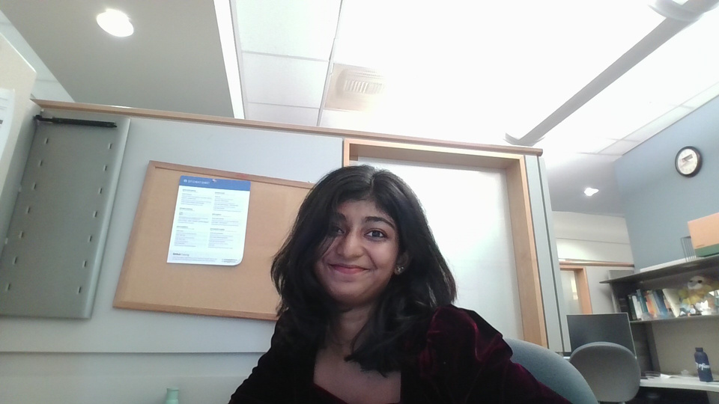


Team
Name: Janani Karthikeyan
Education: Master’s in Data Analytics Engineering
Experience: Data Engineer @Pfizer Inc.
Name: Bagheshri Suresh Kumar
Education: Master’s in Data Analytics Engineering
Experience: Data Scientist -Nurturebox, World Bank Group
Name: Kiran Tamilselvan
Education: Master’s in Data Analytics Engineering
Experience: Cellarity- Data Scientist Coop
Notes:
Before we get started, I want to introduce our team. We’ve worked together to analyze key economic trends and their impact on people’s livelihoods."

Slide 3
OUR 3 KEY RESEARCH QUESTIONS
How have wages grown from 2015 to 2024, and are they keeping up with inflation?
How do wage disparities affect unemployment rates and economic inequality?
What trends can be observed in employment costs, productivity, and overall economic stability?
Notes:
*"To guide our discussion, we focused on three major questions:
Have wages kept up with inflation over the past decade?
How do wage disparities influence unemployment and inequality?
What broader trends in employment costs, productivity, and economic stability have we observed?"*

Slide 4
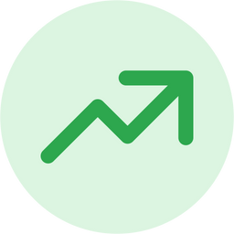
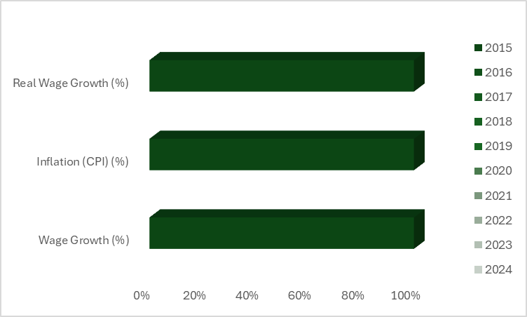
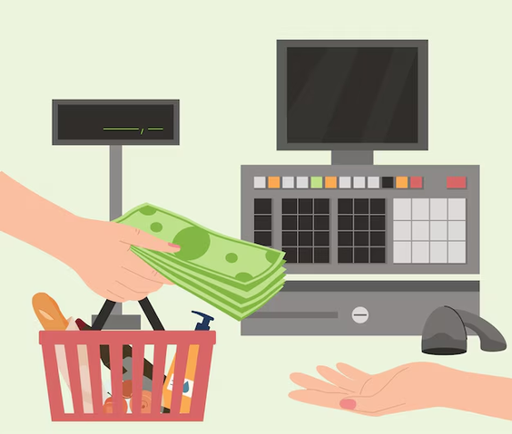
Q1: How have wages grown from 2015 to 2024, and are they keeping up with inflation?
Wage Growth vs. Inflation
Data Source: U.S. Bureau of Labor Statistics
Notes:
Let’s start with wage growth and inflation. On paper, wages have increased over time, but the real question is—have they grown fast enough to keep up with rising costs?

Slide 5

Q1: How have wages grown from 2015 to 2024, and are they keeping up with inflation?
Wage Growth vs. Inflation
Data Source: U.S. Bureau of Labor Statistics

Slide 6

Q1: How have wages grown from 2015 to 2024, and are they keeping up with inflation?
Wage Growth vs. Inflation
Data Source: U.S. Bureau of Labor Statistics

Slide 7

Q1: How have wages grown from 2015 to 2024, and are they keeping up with inflation?
Wage Growth vs. Inflation
Data Source: U.S. Bureau of Labor Statistics

Slide 8
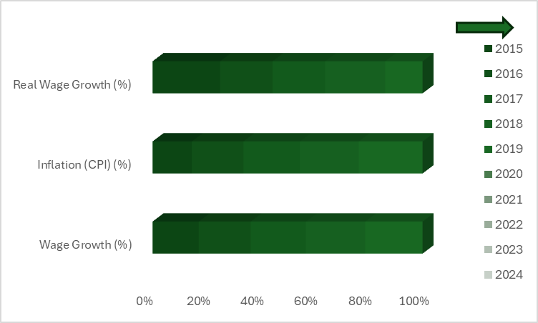

Q1: How have wages grown from 2015 to 2024, and are they keeping up with inflation?
Wage Growth vs. Inflation
Data Source: U.S. Bureau of Labor Statistics

Slide 9
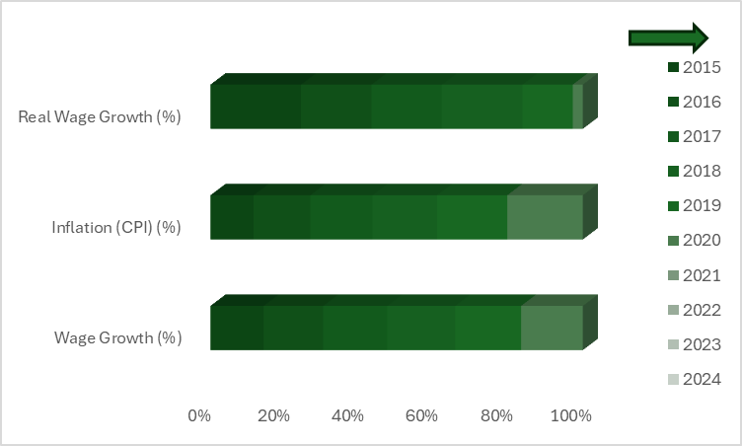
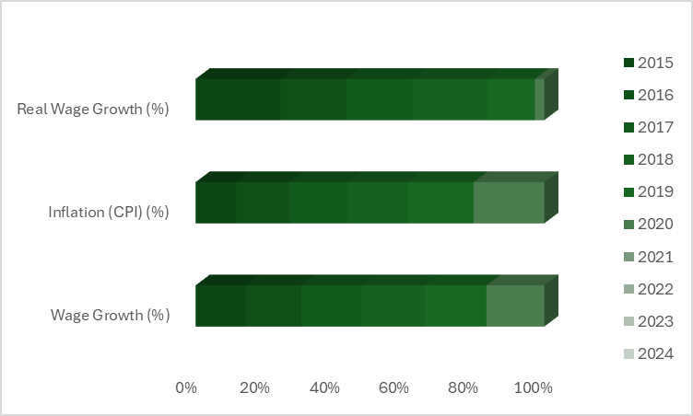
Q1: How have wages grown from 2015 to 2024, and are they keeping up with inflation?
Wage Growth vs. Inflation
Data Source: U.S. Bureau of Labor Statistics

Slide 10
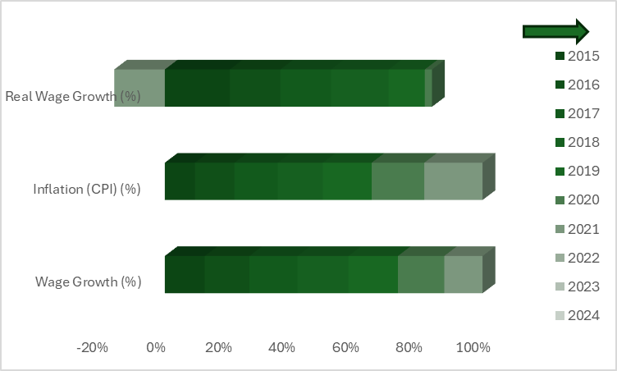
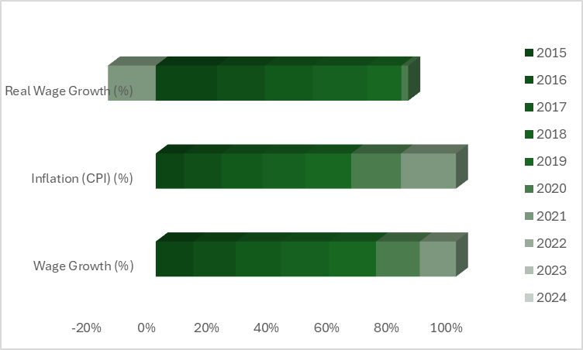
Q1: How have wages grown from 2015 to 2024, and are they keeping up with inflation?
Wage Growth vs. Inflation
Data Source: U.S. Bureau of Labor Statistics

Slide 11
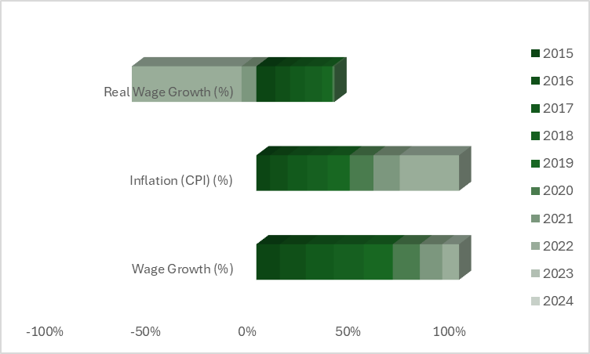
Q1: How have wages grown from 2015 to 2024, and are they keeping up with inflation?
Wage Growth vs. Inflation
Data Source: U.S. Bureau of Labor Statistics

Slide 12
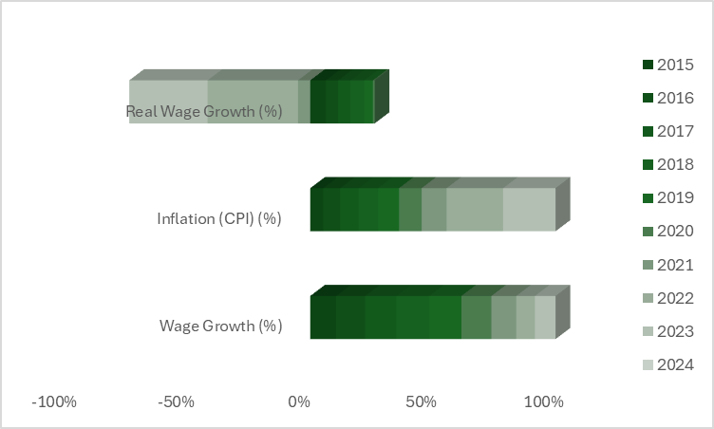
Q1: How have wages grown from 2015 to 2024, and are they keeping up with inflation?
Wage Growth vs. Inflation
Data Source: U.S. Bureau of Labor Statistics

Slide 13
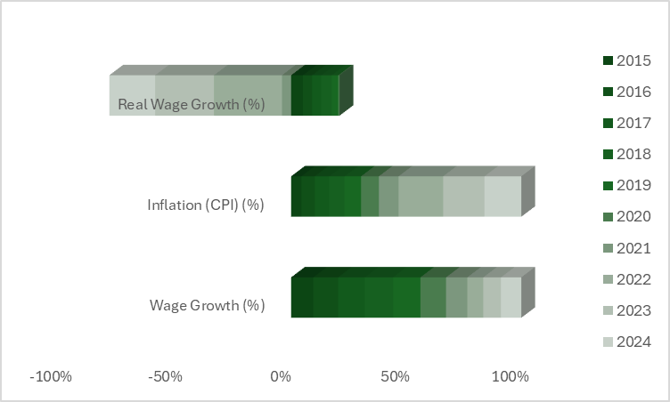
Q1: How have wages grown from 2015 to 2024, and are they keeping up with inflation?
Wage Growth vs. Inflation
Wage growth has increased over time, but inflation spikes have eroded real income gains in some years.
The most significant gap between wages and inflation occurred in 2021-2023, impacting purchasing power
Data Source: U.S. Bureau of Labor Statistics
Notes:
Here I have represented yearly trend data using an animated stacked bar chart between real wage, inflation and wage growth.
Looking at the data, we see that inflation has spiked in certain years, particularly from 2021 to 2023. This eroded the real purchasing power of workers, meaning even if people earned more, their money didn’t go as far. The gap between wages and inflation was especially wide during this period, making everyday expenses harder to afford.

Slide 14
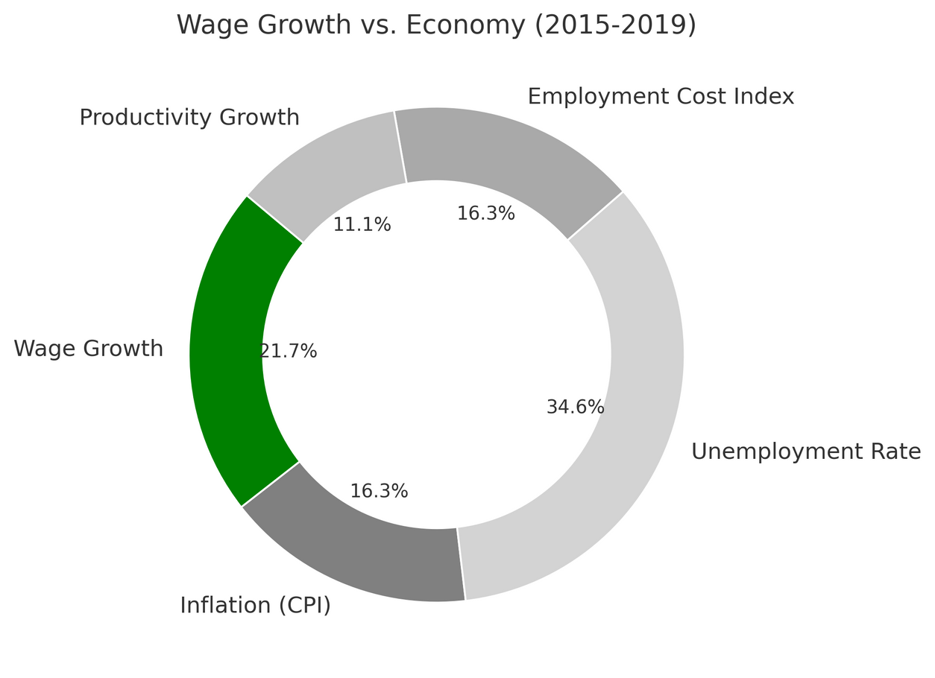
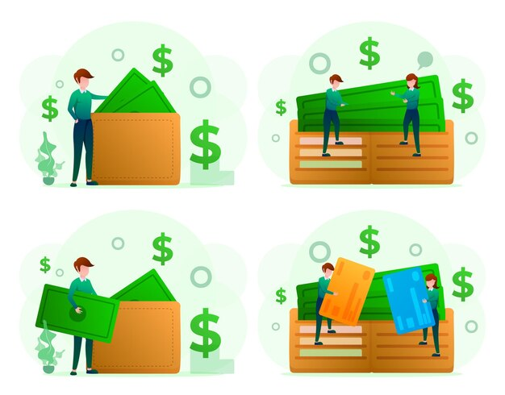
Q1: How have wages grown from 2015 to 2024, and are they keeping up with inflation?
Wage Growth vs. Economy
(2015-2019)
Data Source: U.S. Bureau of Labor Statistics
Notes:
This is a donut chart representation between wage growth and economy. Breaking this down further, from 2015 to 2019, we can see relatively stable wage growth.

Slide 15
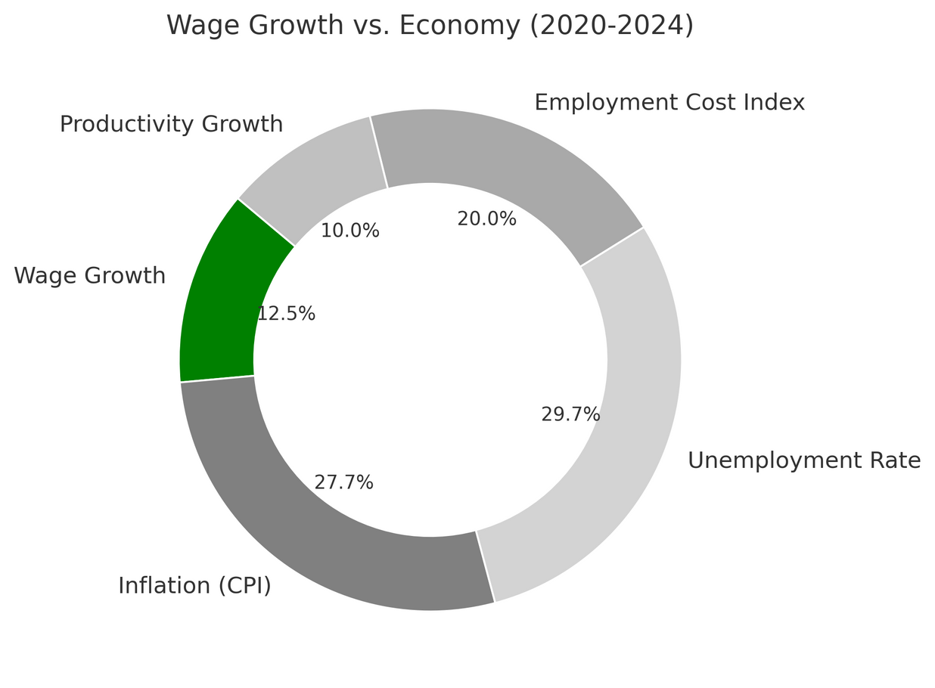

Q1: How have wages grown from 2015 to 2024, and are they keeping up with inflation?
Wage Growth vs. Economy
(2020-2024)
Higher Inflation & Unemployment (2020-2024): Inflation and unemployment spiked, signaling economic instability.
Slower Wage Growth: Wages lagged behind rising costs, reducing real income gains.
Data Source: U.S. Bureau of Labor Statistics
Notes:
However, from 2020 onwards, the economy faced major disruptions—COVID-19, supply chain issues, and rising inflation. These factors led to unemployment spikes and weaker wage growth in real terms.“ now Bageshri will continue explaining the factors affecting unemployment

Slide 16
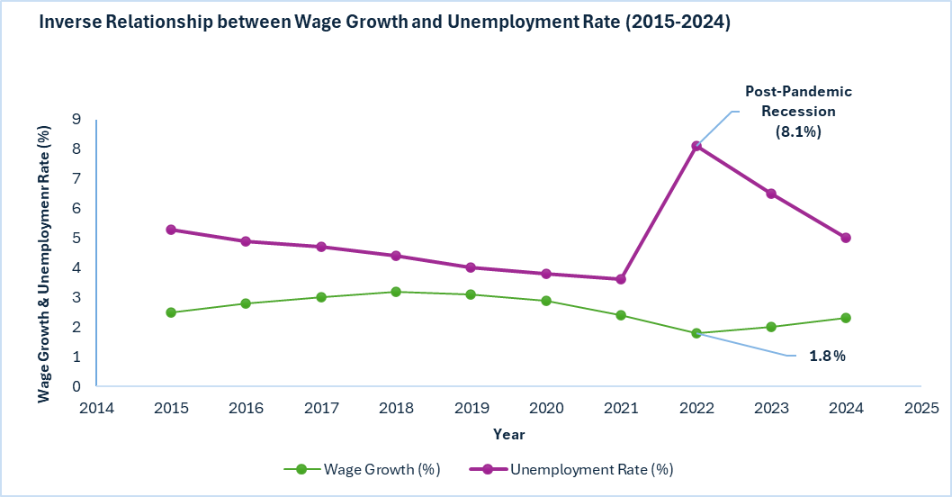

Q2: How do wage disparities affect unemployment rate?
Inverse relationship: Higher wage growth generally leads to lower unemployment.
2022 anomaly: A sharp unemployment spike (8.1%) likely due to a post-pandemic recession, or economic disruptions
Data Source: U.S. Bureau of Labor Statistics
Notes:
How do wage disparities affect unemployment? Generally, when wages grow, unemployment tends to decline. But in 2022, we saw an exception—a sharp spike in unemployment despite wage growth. This anomaly was likely caused by the post-pandemic recession and economic uncertainty."

Slide 17
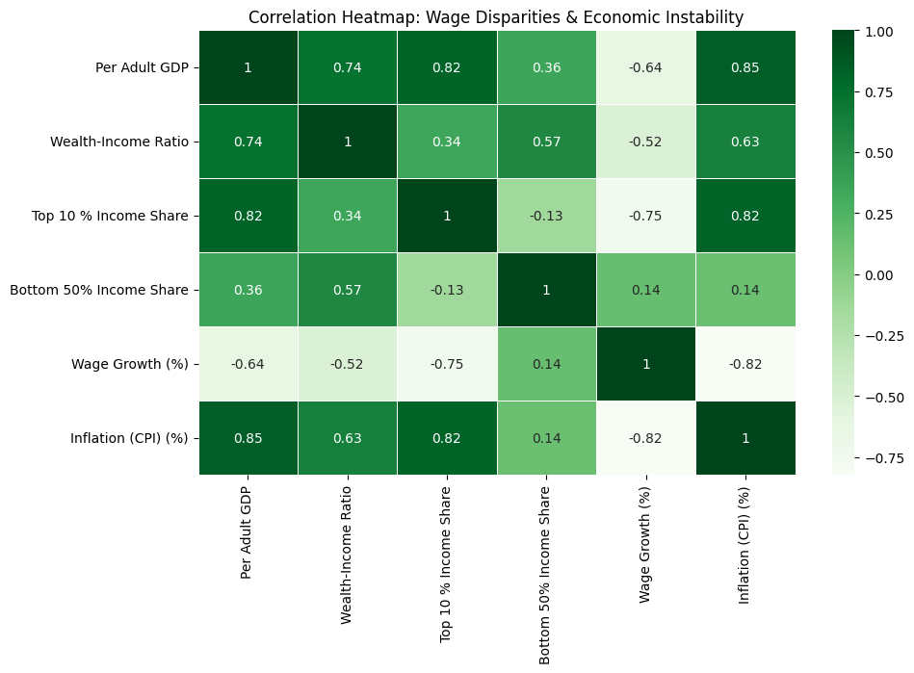
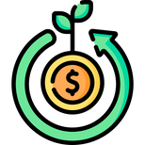
Q2: Impact of Wage Disparity on Economic Inequality
Concentrates Wealth at the Top: Low wage growth keeps income concentrated among the top 10%.
Limits Income Distribution for the Bottom 50%: Wage growth benefit lower-income groups, reducing inequality.
Inflation Worsens Inequality: Rising prices benefit the wealthy more, increasing disparity.
Data Source: World Inequality Database
Notes:
"One major consequence of wage disparities is wealth concentration. When wage growth is uneven, the top 10% see a larger share of economic benefits, while the bottom 50% struggle to keep up. Inflation worsens this divide, as wealthier individuals can absorb rising costs more easily, increasing overall inequality.“ Kiran will move forward with our third research question.

Slide 18
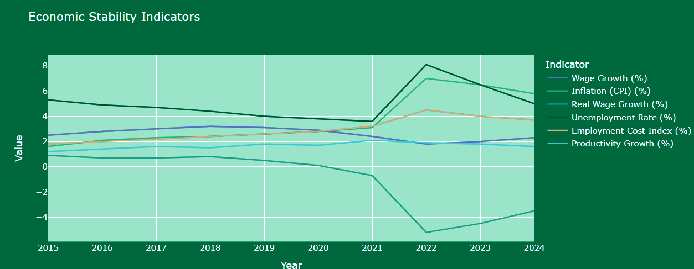
Q3: Economic Stability Indicators
📈 Inflation Spike (2022): Inflation peaked in 2022, outpacing wage growth and reducing purchasing power.
📉 Real Wage Decline: Real wage growth turned negative in 2022, with only slight recovery afterward.
💼 Unemployment Fluctuation: Unemployment fell until 2021, spiked in 2022, then recovered by 2024.
Data Source: World Inequality Database
Notes:
"Economic stability is shaped by multiple factors. Inflation spiked in 2022, outpacing wage growth and reducing purchasing power. Real wage growth even turned negative that year. Meanwhile, unemployment fluctuated—falling until 2021, spiking in 2022, and recovering by 2024. This shows how interconnected these factors are."

Slide 19
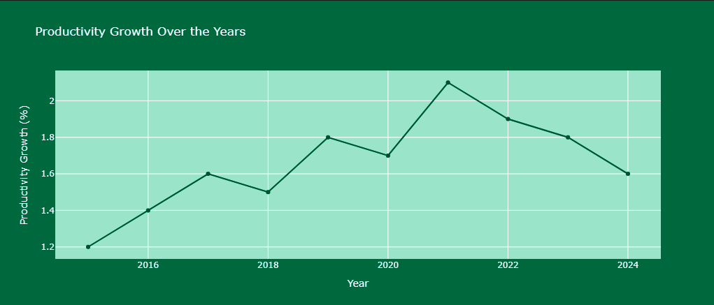
Q3: Productivity Growth Over Years
📈 Steady Growth Until 2021: Productivity showed a consistent upward trend from 2015, peaking in 2021 at 2.1%, indicating enhanced efficiency during this period.
📉 Post-2021 Decline: After reaching its peak, productivity growth gradually declined, falling back to 1.6% by 2024, reflecting potential economic slowdowns or reduced efficiency gains.
⚖️ Overall Stability with Minor Fluctuations: Despite the peak and subsequent decline, productivity growth remained within a stable range of 1.2%–2.1% over the decade, highlighting moderate but consistent economic performance.
Data Source: World Inequality Database
Notes:
"Finally, let’s talk about productivity. From 2015 to 2021, productivity steadily increased, peaking at 2.1%. But after that, it started declining slightly, likely due to economic slowdowns and reduced efficiency gains. Still, overall, productivity has remained relatively stable, fluctuating between 1.2% and 2.1%."

Slide 20

Thank you !
Give us your feedback :)
Notes:
"To wrap up—while wages have risen, inflation has often outpaced them, reducing real income growth. Wage disparities contribute to economic inequality, and external shocks like inflation and recessions can disrupt employment trends. Understanding these dynamics is crucial for policymakers, businesses, and workers alike.“"That brings us to the end of our presentation! Thank you for your time, and we’d love to hear your feedback!"

